Slide 1
Trip Planning
Week 10

Slide 2
WTC Graduation Requirements
Two trips!
Basic requirements:
  Overnight
  Substantial cross-country
  Includes a peak (min: 1)

Slide 3
When to Go
How high?
Winter/early spring – snow
Summer – mosquitoes
Late summer/fall – weather and fire closures
Note: Snow generally melts late June/early July but YMMV.

Slide 4
Where to Go
Sierra Club outing writeups
Friends
Books
  Sierra [North/South]: Backcountry Trips in California’s Sierra Nevada by Wilderness Press
  The High Sierra: Peaks, Passes, Trails by R. J. Secor
Backpacker Magazine

Slide 5
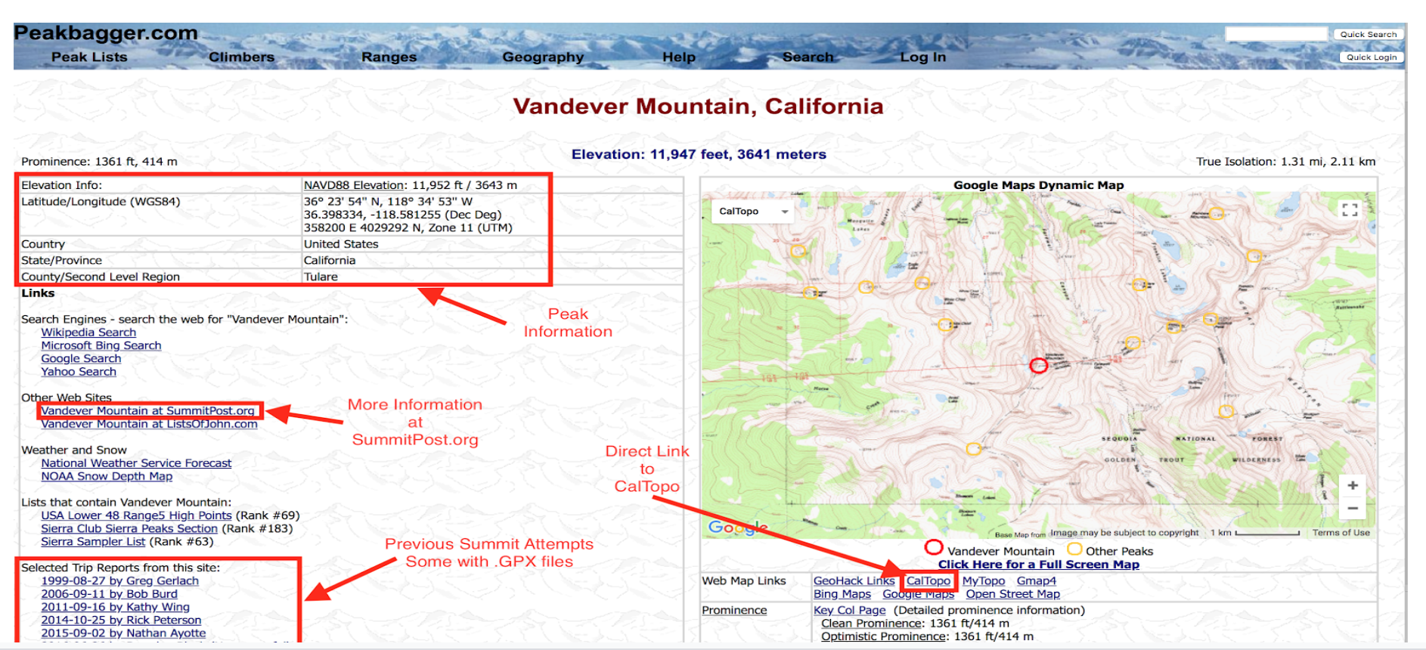
Peak Info: peakbagger.com

Slide 6
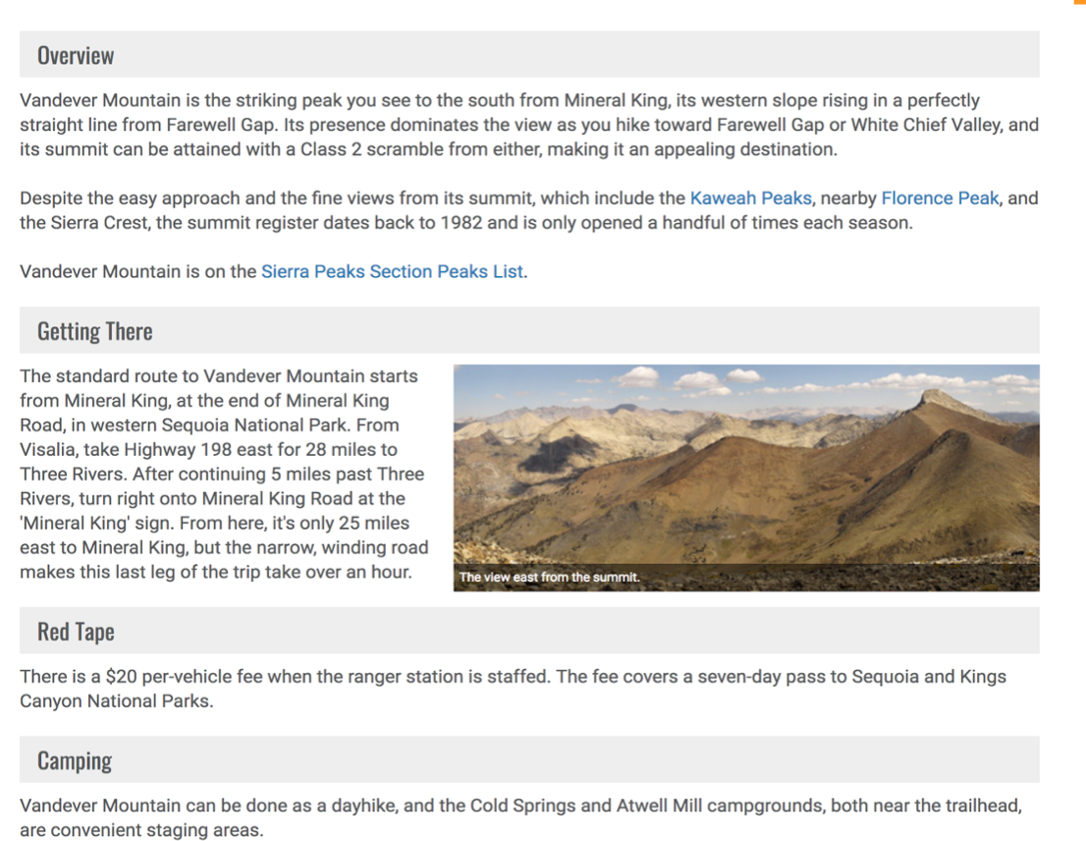
Peak Info: summitpost.org
More detailed information
  How to get to the trailhead
  Red Tape section has information on permits, parking, etc.
  Sometimes camping information, geology, local wildlife is included

Slide 7
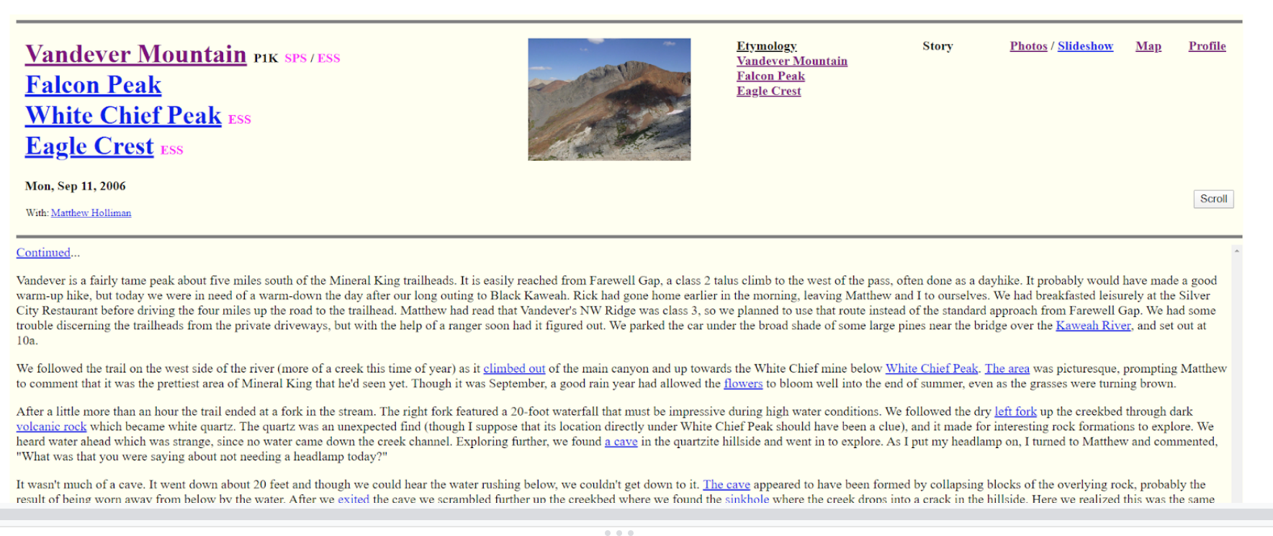
Peak Info: snwburd.com
Good trail and route info
Pictures of trails
Trip report
Map of route

Slide 8

Peak Info: The High Sierra
Extensive information on Sierra Nevada range
Great resource for planning a trip

Slide 9
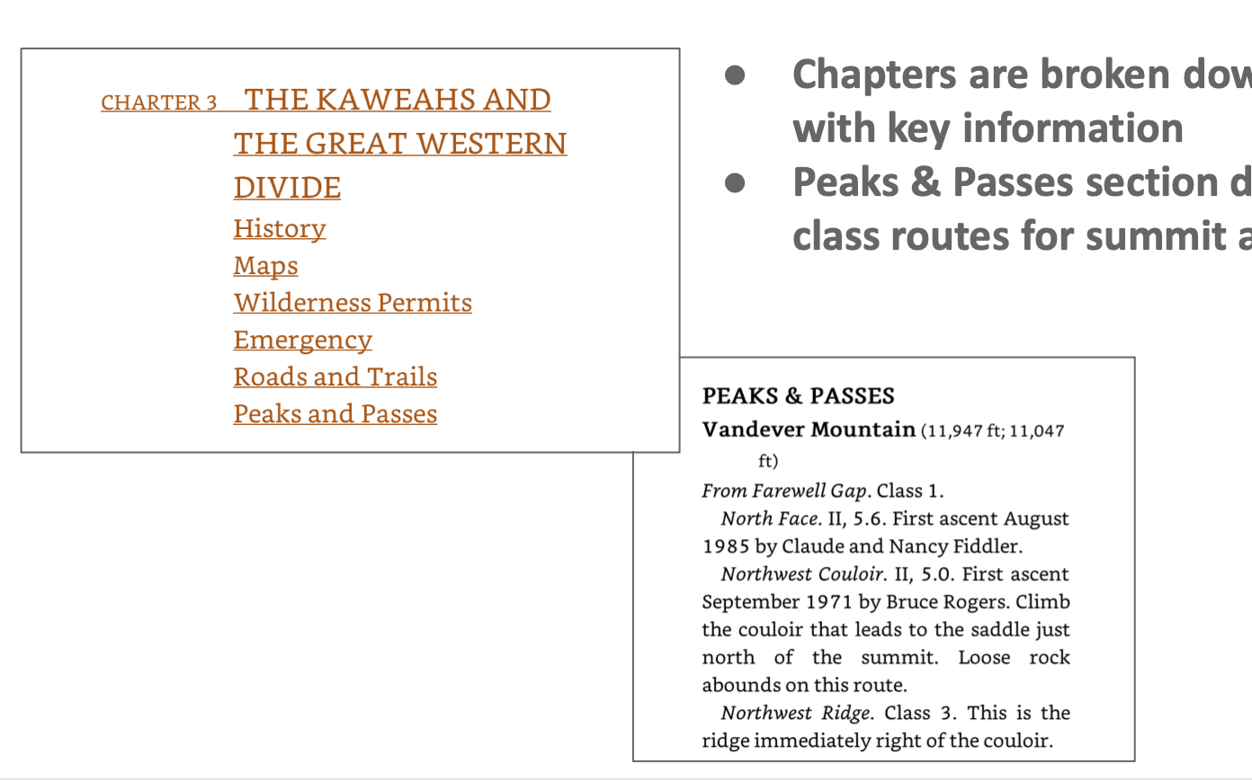
Peak Info: The High Sierra
Chapters are broken down by categories with key info
Peaks & Passes section describes different class routes for summit approach

Slide 10
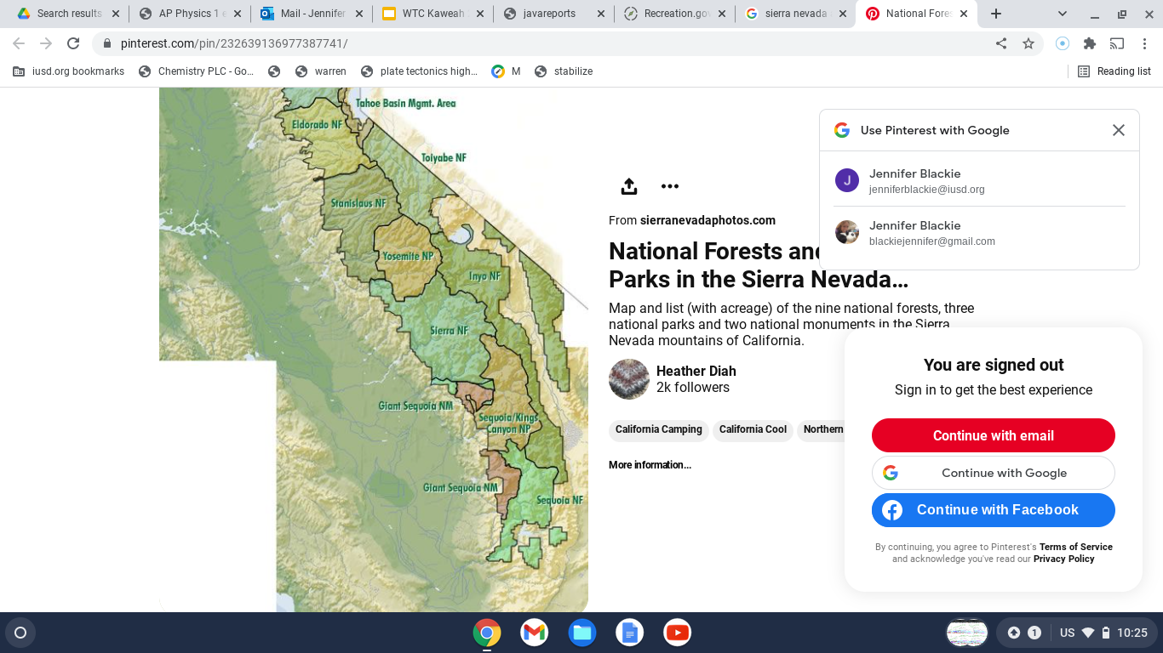
Permits
Issued by local agency
By trailhead and date of entry
Quota vs. non-quota

Slide 11
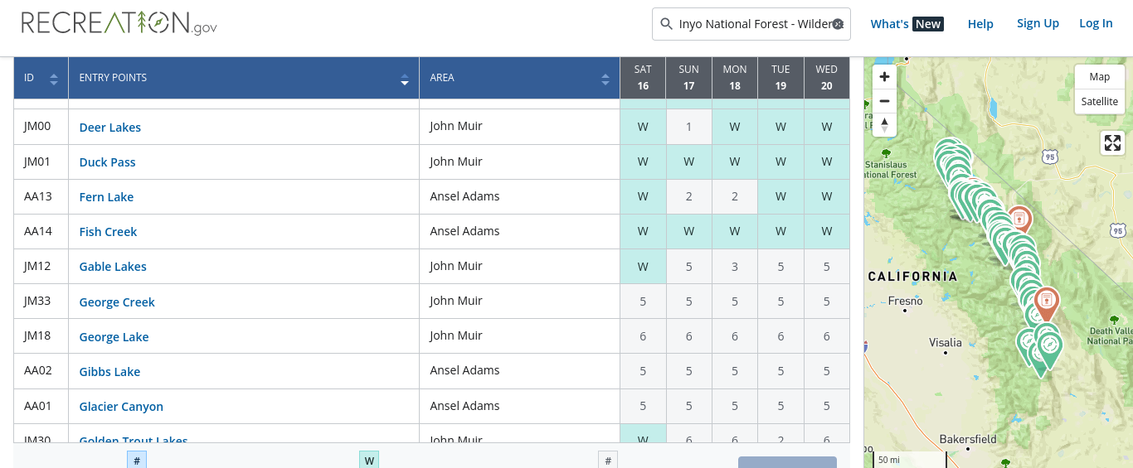
Reserving Permits
Recreation.gov
“Reservable spots” (60% of quota) open 6 months in advance at 7AM

Slide 12
Walk-up Permits
40% of quota
Non-quota trailheads
Depending on agency:
  Reserved online 7 days in advance
  Reserved online 3 days in advance
  Picked up in person starting the day prior

Slide 13
Special Permits
Yosemite
  Lottery 6 months in advance
  “Walk-ups” become available 6 months in advance
  Donohue Pass has its own quota
Whitney
  Lottery in March (yesterday)
  No “walk-up” permits but can take a cancelled spot
  Check recreation.gov

Slide 14
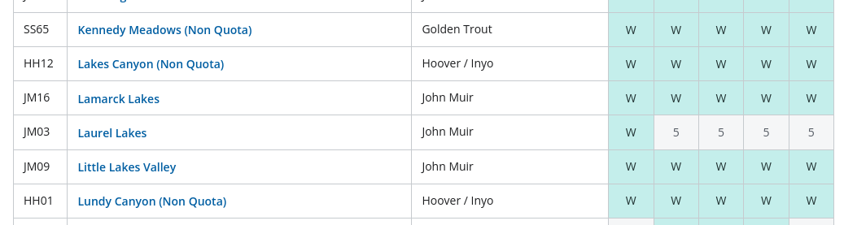
Permit Tips
Check out non-quota trailheads
Go for “walk-up” permits
Be flexible!

Slide 15
Maps
Caltopo.com
Topobuilder.nationalmap.gov
Google Maps (Satellite)

Slide 16
Plan Ahead
Pick an appropriate outing
Know where you’re going
Research weather and conditions (weather.gov, mountain-forecast.com)
Dress for the occasion
Have a turnaround time
Let someone know where you’re going
Notes:
-Pick an appropriate outing. Do something within your skill level. If it’s a long day hike, are you starting early in the morning? Can you handle the altitude?
-Know where you’re going: make sure you have a map and compass with you; your trip will have cross-country!
-Research weather and conditions. Check websites like weather.gov and mountain-forecast.com. They show you forecasts based on where you are on a mountain; factors in elevation. If you use a basic weather site (weather.com or accuweather.com) then it’ll generally give you data for the nearest city.
-Know the conditions: know the conditions (snowy/icy terrain, recent rockfall, flash floods). If there’s firm snow, do you have the right equipment like an ice axe and crampons?
-Dress for the occasion, and then some. Is it going to be very hot or very cold, and are you prepared for that? We always say no cotton; make sure your clothing can wick/dry off. Bring layers.
-Have a turnaround time especially if you’re doing a peak. Give yourself some margin for daylight, especially if you’re unfamiliar with hiking in the dark. Start early.
-Let someone know where you’re going, and when you intend to return. Especially important for solo hiking. Even if you are in a group, you have to assume there is a chance you may be separated. You should let someone at home know where you are going and when you plan to return. They can relay this information to the authorities.

Slide 17
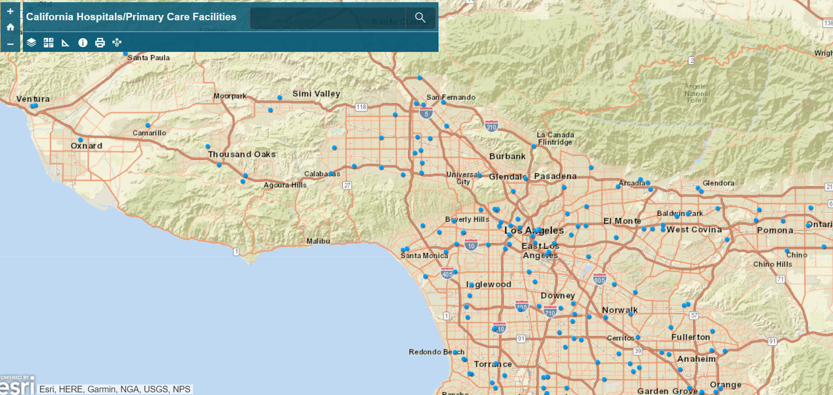
In Case of Emergency
Personal locator beacons and satellite communicators
Local SAR phone number
Closest hospital: Use Bob’s app
Emergency contact information

Slide 18
After the Outing
Fresh clothes and cooler w/ drinks
Make sure everyone’s cars start
Celebrate!
Send pics
Submit paperwork

Slide 19
Have fun!

